Slide 1
MeAsurement of F₂^{n}/F₂^{p}, d/u RAtios and A=3 EMC Effect in Deep Inelastic Electron Scattering Off the Tritium and Helium MirrOr Nuclei
JLab Experiment E12-10-103 - Update
J. Gomez for G. Petratos &
the JLab MARATHON Collaboration
Hall A Collaboration Meeting
JLab, December 2014

Slide 2
Overview and Goals of the Experiment
MARATHON Experiment will measure the ratio of deep inelastic electron scattering from the 3H and 3He mirror nuclei using the BigBite (at large angles) and the Left HRS (at small angles) magnetic spectrometers.
Tritium gas target of ~1.1 kCi (see D. Meekins presentation).
The ratio of the two cross sections will determine the ratio of the neutron to proton F₂ structure functions, and the ratio of the d/u quark distribution functions in the nucleon.
Nuclear corrections have been estimated to be small (order 1%).
Experiment will measure the EMC effect for both 3H and 3He (using a deuterium cell).
A=3 EMC effect data and their ratio are considered crucial for understanding the EMC effect.

Slide 3
Deep Inelastic Scattering and Quark Parton Model
DIS cross section - Nucleon structure functions F₁ and F₂:
QPM interpretation in terms of quark momentum proba-
bility distributions q_{i}(x) (large Q² and ν, fixed x):
Bjorken x: fraction of nucleon momentum carried by
struck quark:

Slide 4
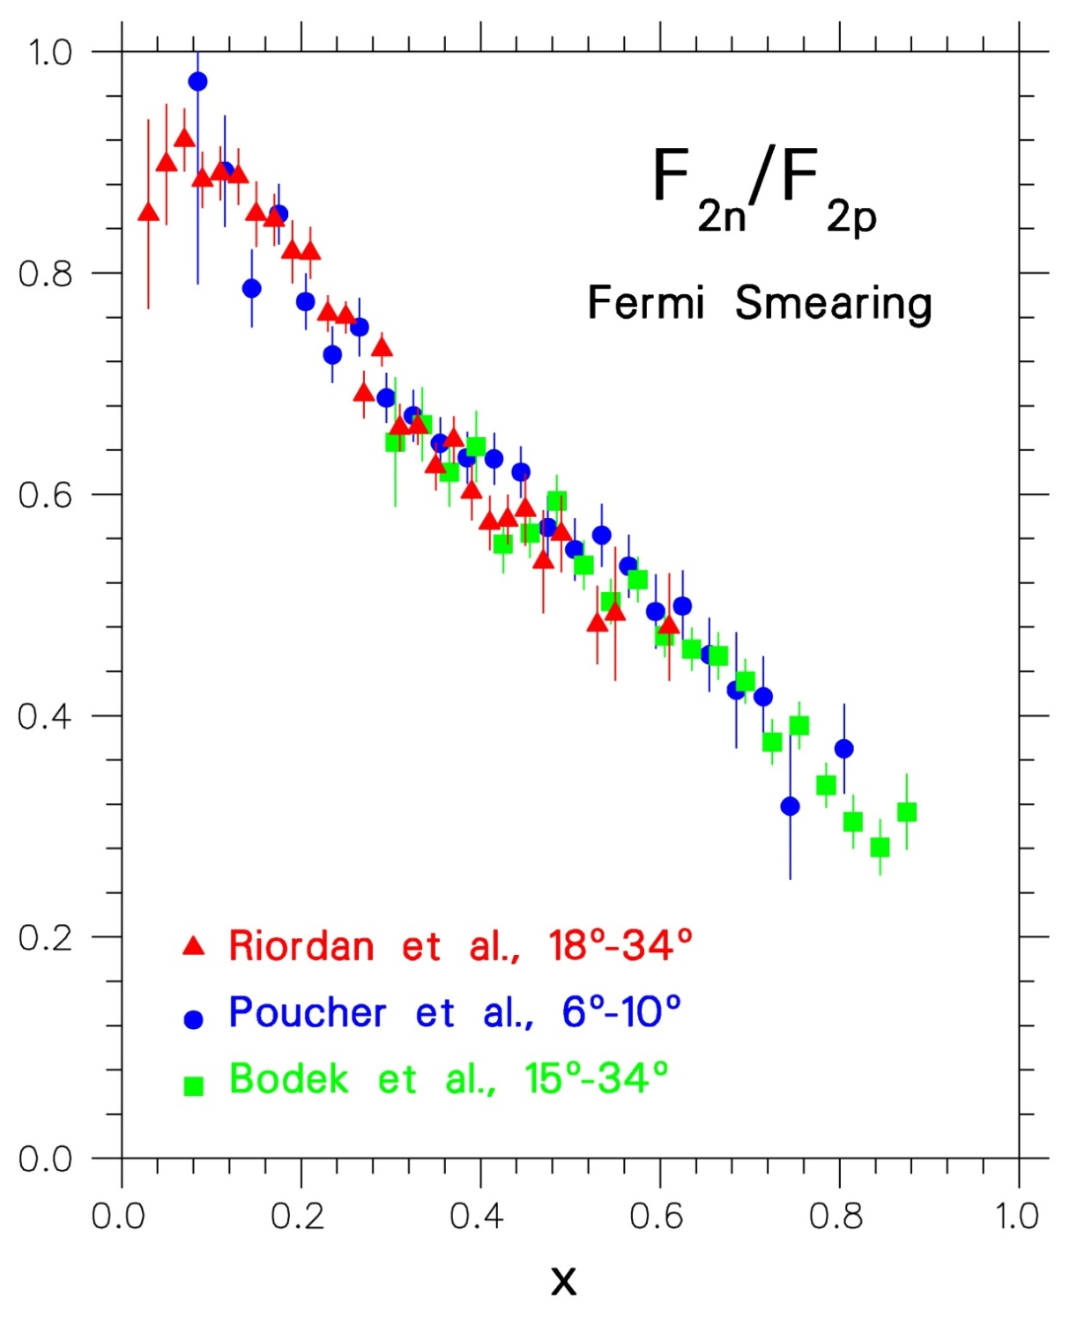
SLAC 1968-1972
Friedman, Kendall, Taylor
Nobel 1991
F₂^{n}/F₂^{p} extracted from p and d DIS
using a Fermi-smearing model and a non-relativistic N-N potential
Data in disagreement with
SU(6) prediction: 2/3=0.67!
High momentum quarks in
p(n) are u(d) valence quarks
There are no high momentum strange quarks in p and n
Sea quarks dominate at small x
Data consistent with di-quark model by Feynman and others

Slide 5
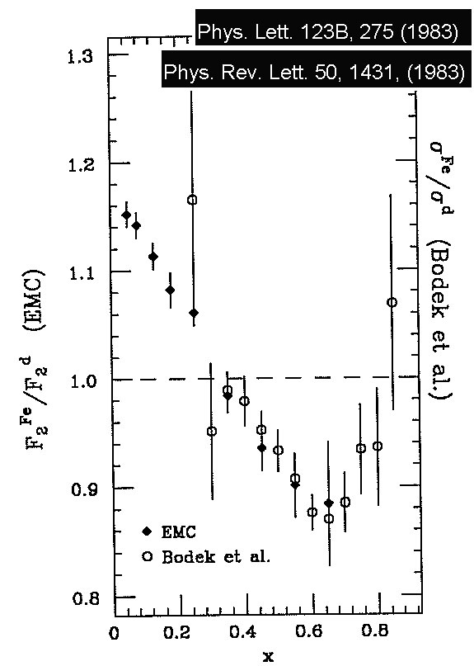
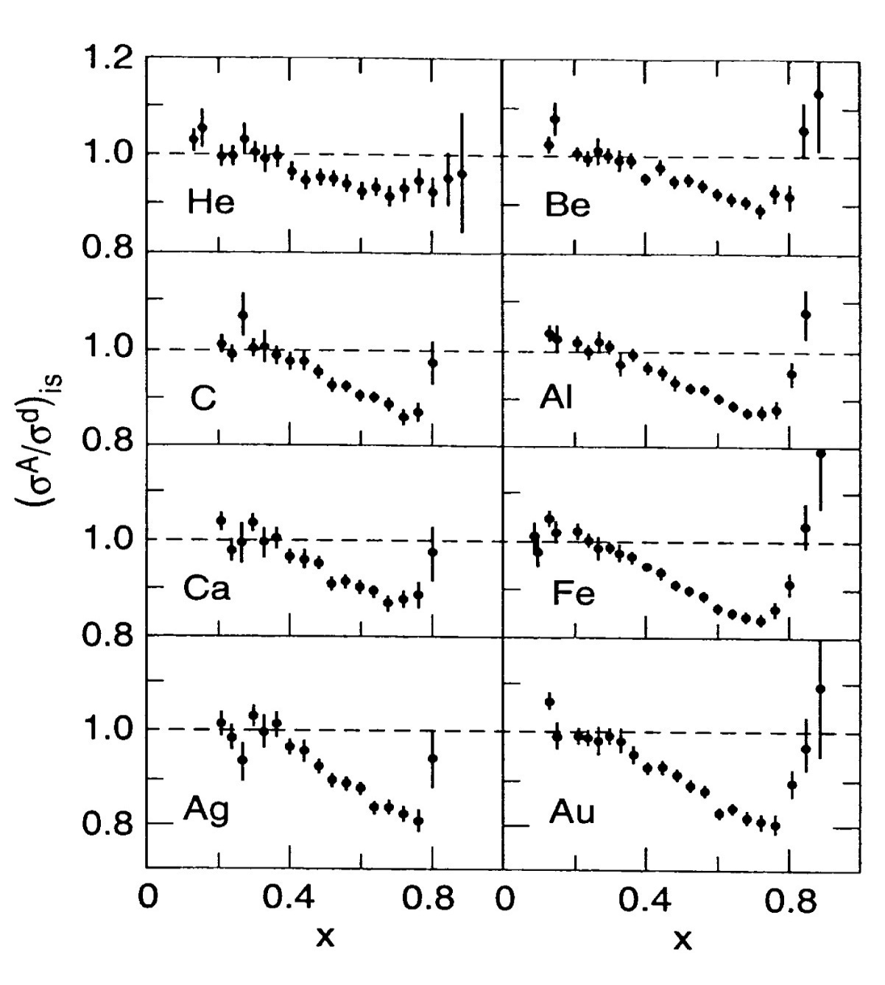
and then the EMC effect ……
(appears to be Q² independent)
Phys. Rev. Lett. 52, 727 (1984)

Slide 6
Structure Function Ratio Problem !
Convolution model:
Fermi motion and binding, covariant deuteron wave function, off-shell effects :
[Melnitchouk and Thomas (1996)]
Nuclear density model:
EMC effect for deuteron scales with nuclear density:
[Frankfurt and Strikman (1988)]
Nuclear density
model
Smearing AND Binding
Fermi smearing

Slide 7
F₂^{n}/ F₂^{n}, d/u Ratios and A₁ Limits for x→1
 | F₂^{n}/F₂^{p} | d/u | A₁^{n} | A₁^{p}
SU(6) | 2/3 | 1/2 | 0 | 5/9
Diquark/Feynman | 1/4 | 0 | 1 | 1
Quark Model/Isgur | 1/4 | 0 | 1 | 1
Perturbative QCD | 3/7 | 1/5 | 1 | 1
Quark Counting Rules | 3/7 | 1/5 | 1 | 1
A₁: Asymmetry measured with polarized electrons and nucleons. Equal in
QPM to probability that the quark spins are aligned with the nucleon spin.
A₁^{p}, A₁^{n}: Extensive experimental programs at CERN, SLAC, DESY and
JLab (6 GeV and 12 GeV Programs)

Slide 8
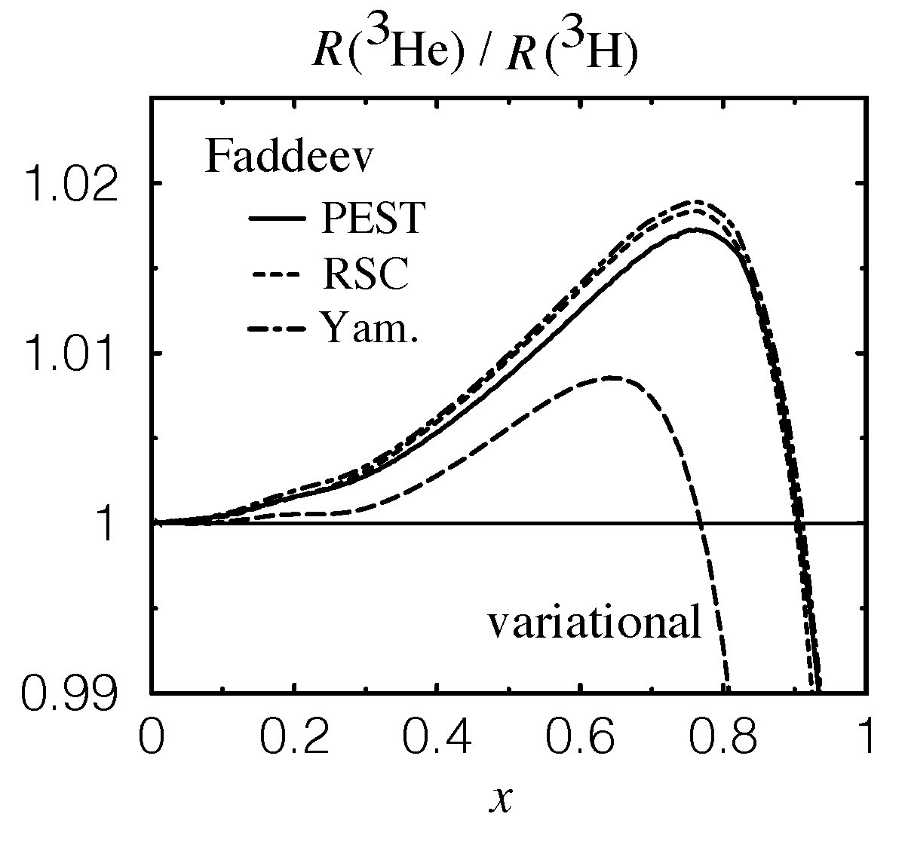
R* =
Phys. Rev. C68 035201 (2003)

Slide 9
Nucleon F₂ Ratio Extraction from ³He/³H
Just perform DIS from ³He and ³H. Binding of nucleons in
the two nuclei is of same nature. Difference between bound
and free nucleons in the two nuclei is calculable, summarized, for their ratio, by some parameter R* (W. Melnitchouk et al.).
If R=σ_{L}/ σ_{T} is the same for ³He and ³H, measured DIS cross
section ratio must be equal
to the F₂ structure function
ratio as calculated using R*:
Determine nucleon F₂ ratio
using A=3 DIS cross section
data and R*(≈1) from theory:

Slide 10
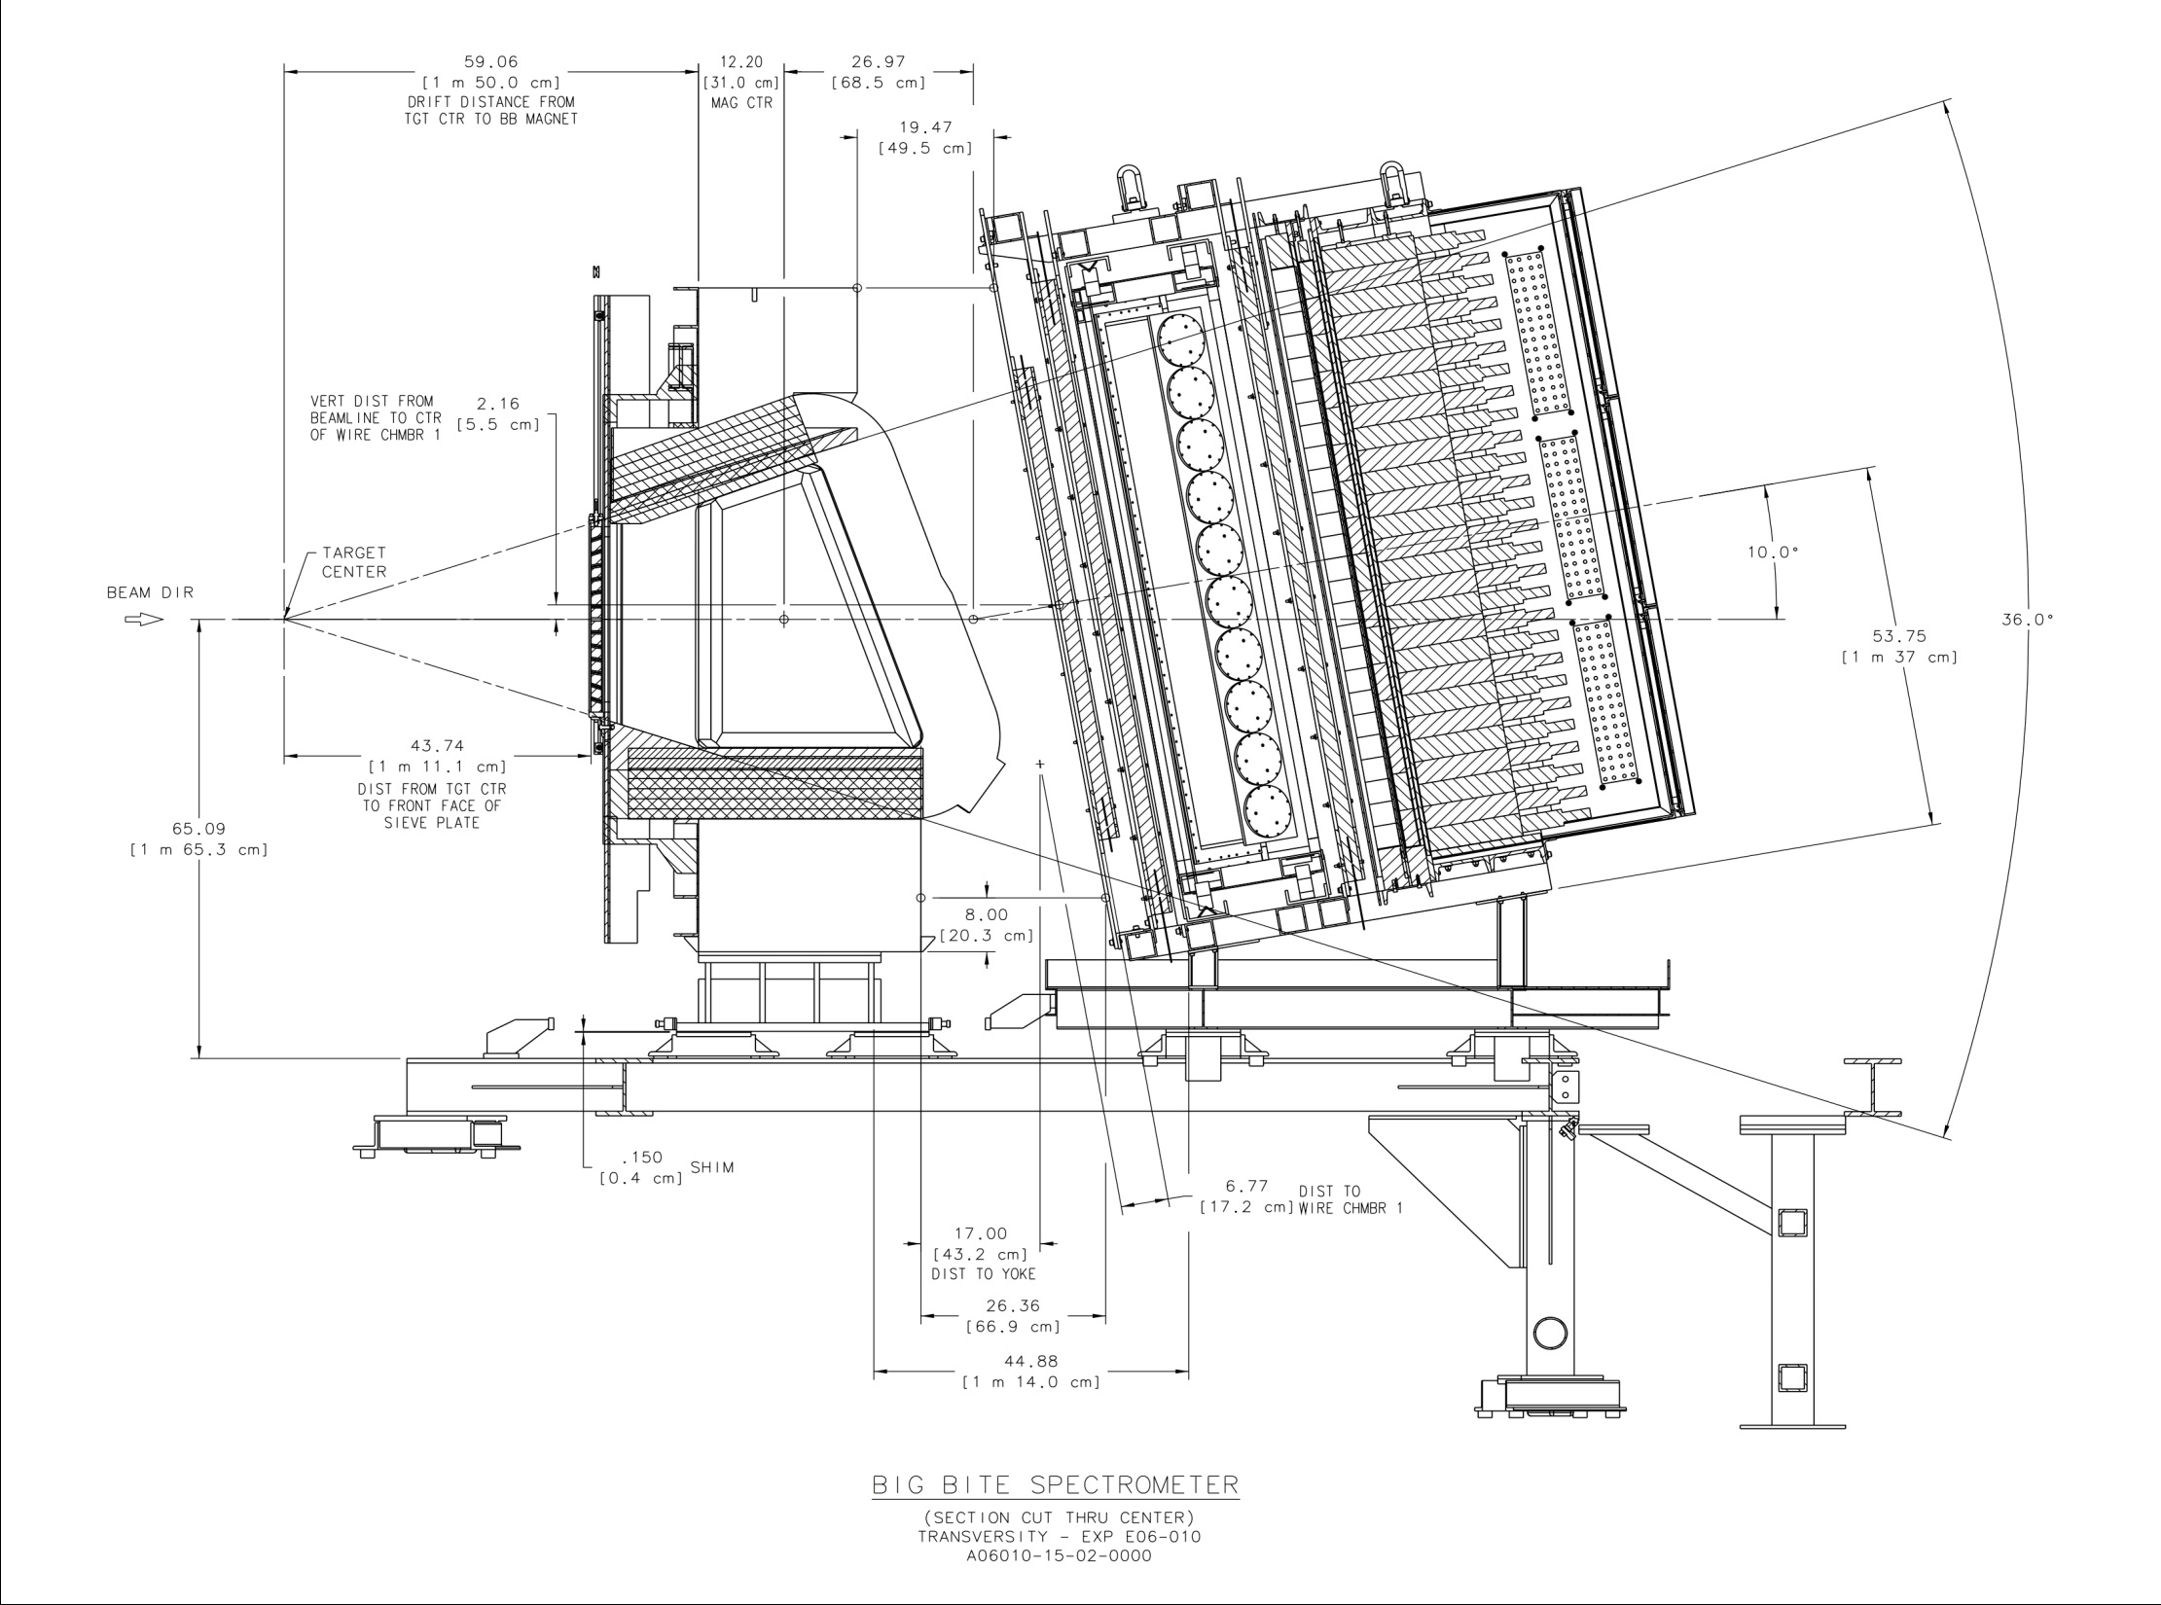
Side View
BigBite Spectrometer

Slide 11
Work in Progress
Putting back the BigBite Spectrometer together
Re-cabling and checking of detectors
Re-installation of front end electronics
Resetting the DAQ system
Search for Cerenkov counter replacement phototubes
Search for C₄F₈O Gas vendor
Planning for basic magnetic field magnetic measurements
Modeling of the BigBite magnetic field
& really working in MARATHON/BigBite/³H exp.
L. Myers, D. Higinbotham (JLab), M. Olson (St. Norbert)
S. Alsalmi, T. Hague, M. Nycz, T. Su (Kent State), D. Nguyen, +1 (UVA), J. Bane (Tennesse), S. Li (UNH), J. Campbell (St. Mary), +2 (Tel Aviv, ODU), …… (I apologize for anyone I have missed)

Slide 12
Experimental Plan and Requirements
³He/³H DIS measurements approved to run in Hall A:
Beam Energy: 11.0 GeV – Beam Current: 25 µA
Small angles (15º - 23º): Left HRS system
Large angles (4 settings: 42º , 47º , 52º, 57º): BigBite system
~700 hours for d/u measurement (@ 100% efficiency)
Desirable to check that the ratio R=σ_{L}/σ_{T} is the same for ³He and ³H: Rosenbluth separation of DIS cross section. Need dedicated 3.3, 4.4, 5.5, 6.6, 7.7, 8.8 GeV energies.
Wide angular range (13º - 68º): Left HRS system
~300 hours for R=σ_{L}/σ_{T} measurement (@ 100% efficiency)
Need target system with helium/tritium/deuterium/hydrogen high pressure cells: 25 cm long, 1.25 cm diameter, 14 atm (³H), 30 atm (¹H, ²H, ³He). (See status report by Dave Meekins).

Slide 13
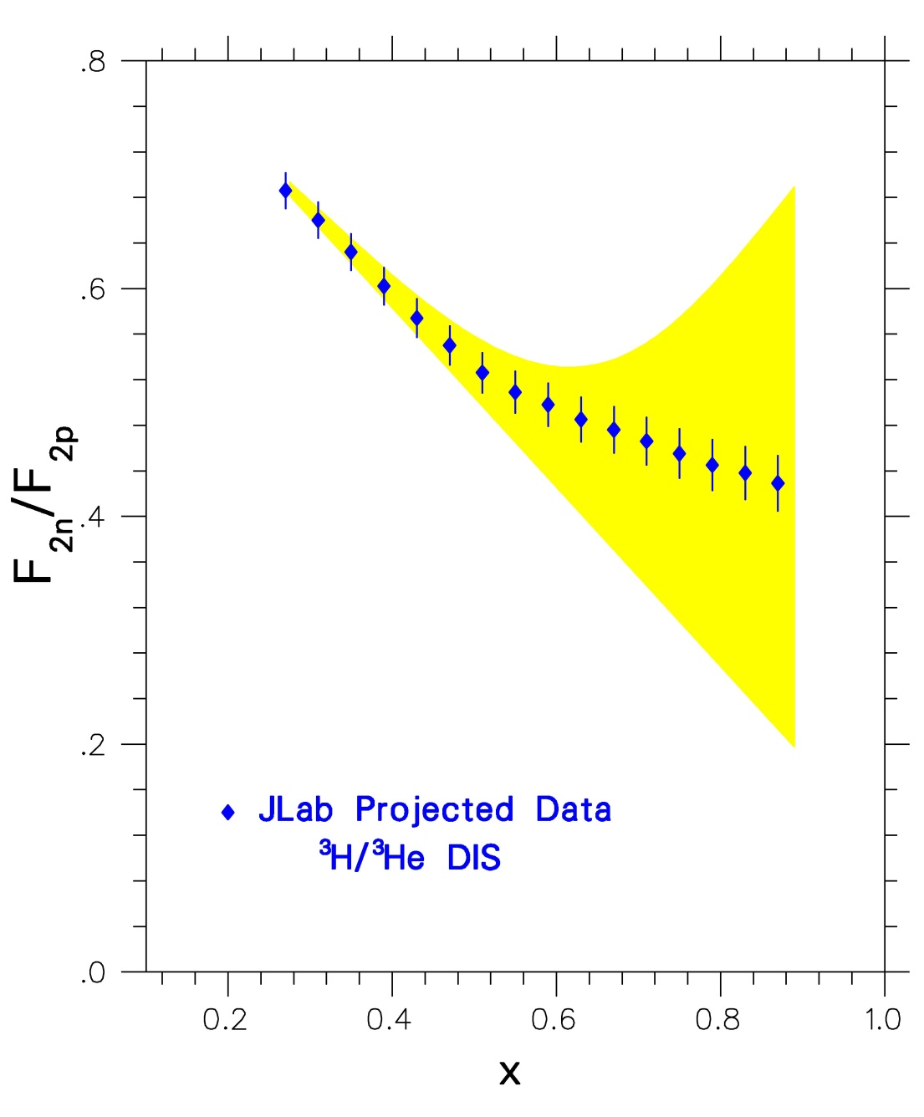
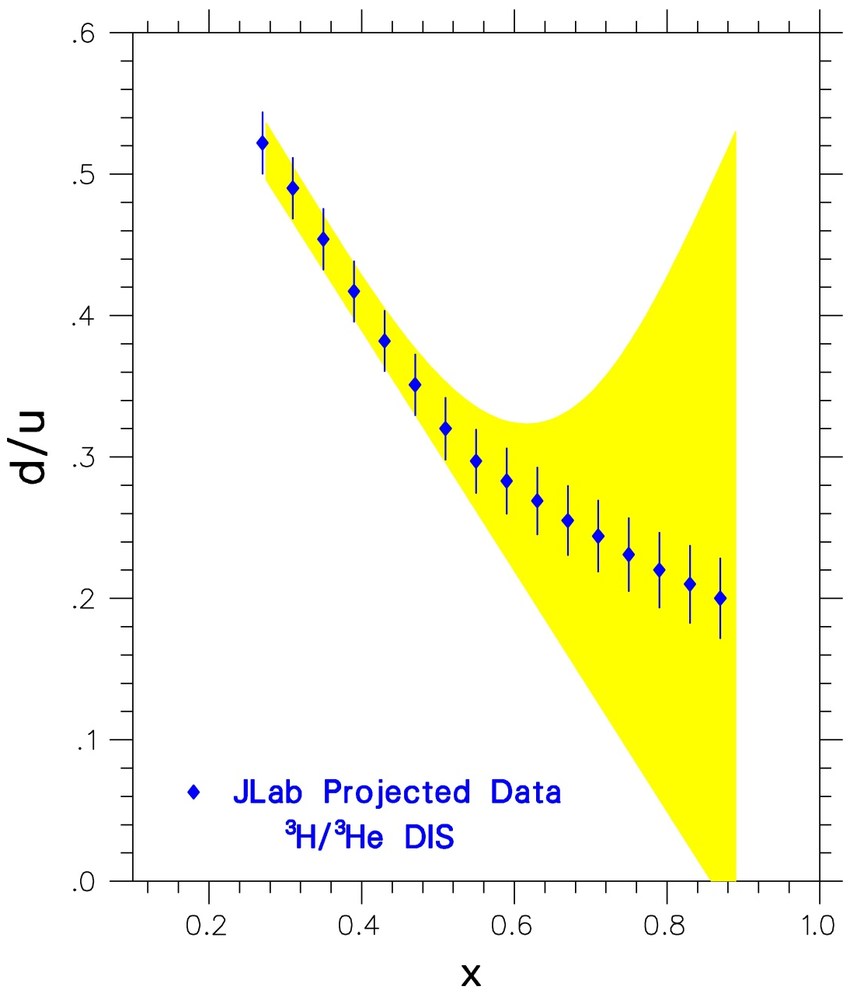
Possible Jlab - Hall A Data for F₂^{n}/F₂^{p} and d/u Ratios
HIGHEST Bjorken x DIS measurements

Slide 14
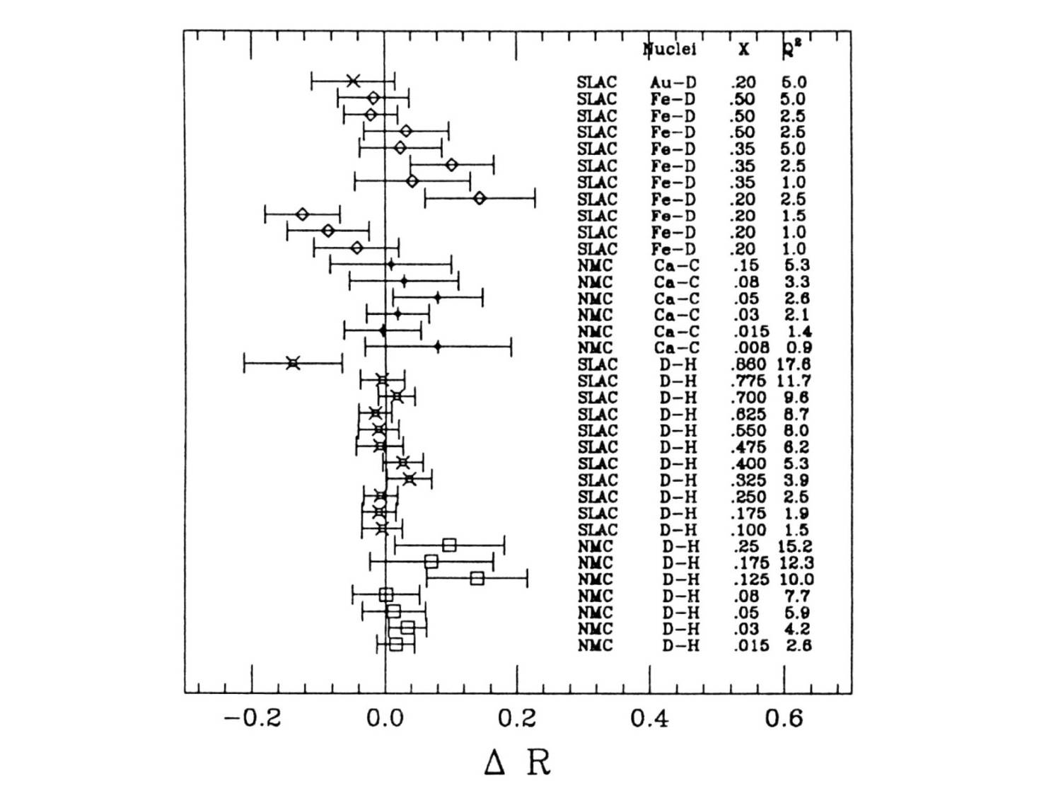
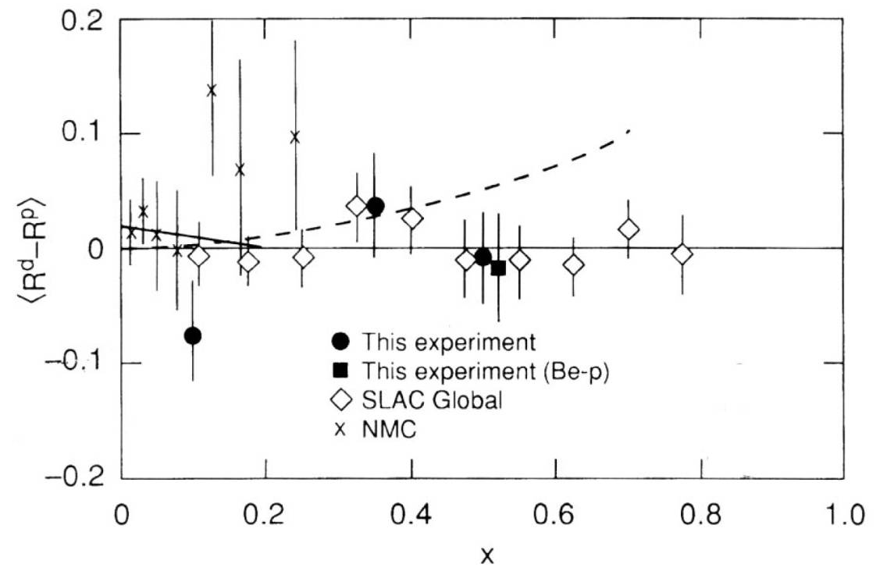
R=σ_{L}/σ_{T} Measurements
SLAC/CERN data show that the
ratio R=σ_{L}/σ_{T} is the same for all
nuclei within experimental errors
³He/³H JLab data will be of better precision
than SLAC data [wider angular range!]

Slide 15
Summary - Issues
E12-10-103 experiment on DIS from ³He and ³H in will provide:
The world’s highest-x measurements of F₂^{n}/F₂^{p} and d/u ratios
Crucial unique EMC effect data for both A=3 systems
Important input to light-nuclei structure theory, and
to nucleon structure function parametrizations
Experiment requires:
11 GeV beam, 42 days with 25 µA beam @100% efficiency
A 1,100 Ci tritium target
Putting back the BigBite spectrometer
Identifying some missing components (e.g. phototubes)
The Left HRS operating at 4.0 GeV
Gradual enhancement of collaborator presence on site (postdocs, faculty on research leaves etc, more students?)

